Slide 1
Contents
Reinforcement Learning
Bellman Equation
Deep Reinforcement Learning
Notes:
https://www.freecodecamp.org/news/a-brief-introduction-to-reinforcement-learning-7799af5840db/
https://www.guru99.com/reinforcement-learning-tutorial.html
https://www.javatpoint.com/reinforcement-learning
https://wiki.pathmind.com/deep-reinforcement-learning

Slide 2
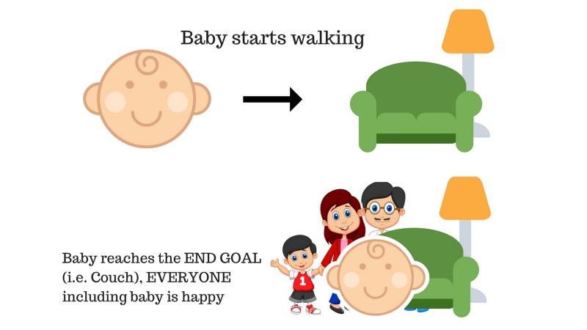
Reinforcement Learning
Agent learns to behave in an environment by performing actions
Observing the reward / result which it gets based upon those actions
Daily Example of reinforcement learning
Baby starts walking and successfully reaches couch
Assume couch is end goal making parents and baby happy
If everyone is happy then baby gets appreciation from parents
happiness => Positive feedback / reward
2

Slide 3
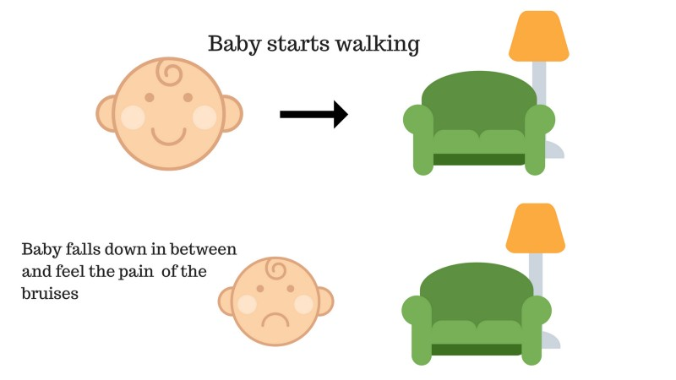
Reinforcement Learning
Daily Example of reinforcement learning
Baby starts walking and fails reaching couch and gets hurt
Assume couch is end goal
Failing to reach couch and getting hurt makes baby unhappy
Baby fails to reach couch and falls down and gets hurt
injury => Negative feedback / no-reward
That’s how humans learn
trail and error
Reinforcement Learning
Learn by actions
3

Slide 4
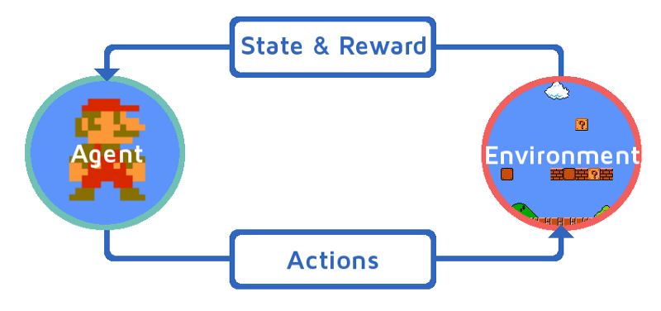
Learning to play Mario brothers
Learning process can be modeled as iterative loop
The RL Agent receives state S⁰ from the environment i.e. Mario
Based on that state S⁰, the RL agent takes an action A⁰, say — our RL agent moves right. Initially, this is random.
Now, the environment is in a new state S¹ (new frame from Mario or the game engine)
Environment gives some reward R¹ to the RL agent. It probably gives a +1 because the agent is not dead yet.
This RL loop continues until we are dead or we reach our destination, and it continuously outputs a sequence of state, action and reward.
The basic aim of our RL agent is to maximize the reward.
4

Slide 5
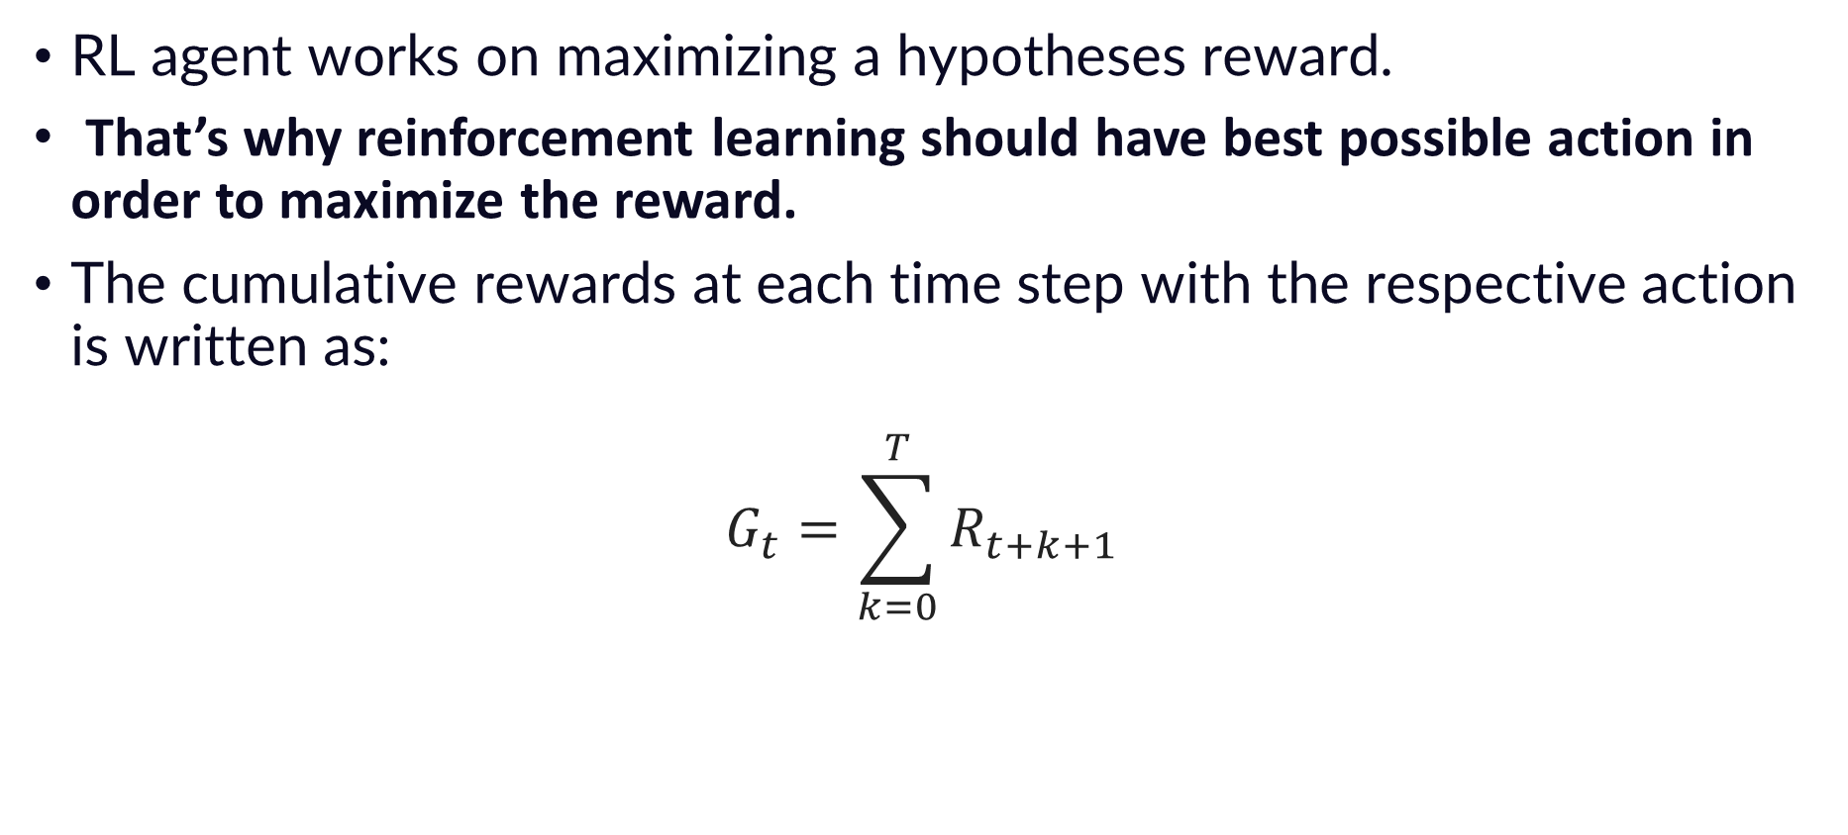
Reward Maximization
RL agent works on maximizing a hypotheses reward.
That’s why reinforcement learning should have best possible action in order to maximize the reward.
The cumulative rewards at each time step with the respective action is written as:
$$G_{t}=\sum_{k=0}^{T}{R_{t+k+1}}$$
5

Slide 6
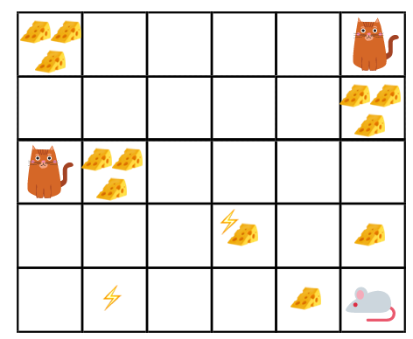
Example
Our agent is a robotic mouse and is placed in a maze with cheese (reward), electric shock (punishment), cat (punishment).
Goal: Eat maximum cheese before getting electrocuted or eaten by cat
Should mouse eat more cheese close to cat or electricity ?
Should mouse eat less cheese far from cat or electricity ?
Eat cheese far from cat or electricity, because the closer to them the higher the probability of death.
Result=> Reward near cat or electricity, even if it is bigger (more cheese), will be discounted. This is done because of the uncertainty factor.
6

Slide 7
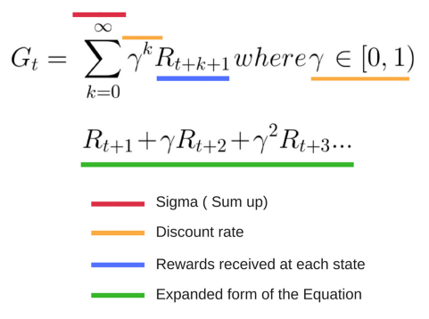
How to discount reward ?
We define a discount rate called gamma.
Its value is between 0 and 1.
The larger the gamma, the smaller the discount and vice versa.
7

Slide 8
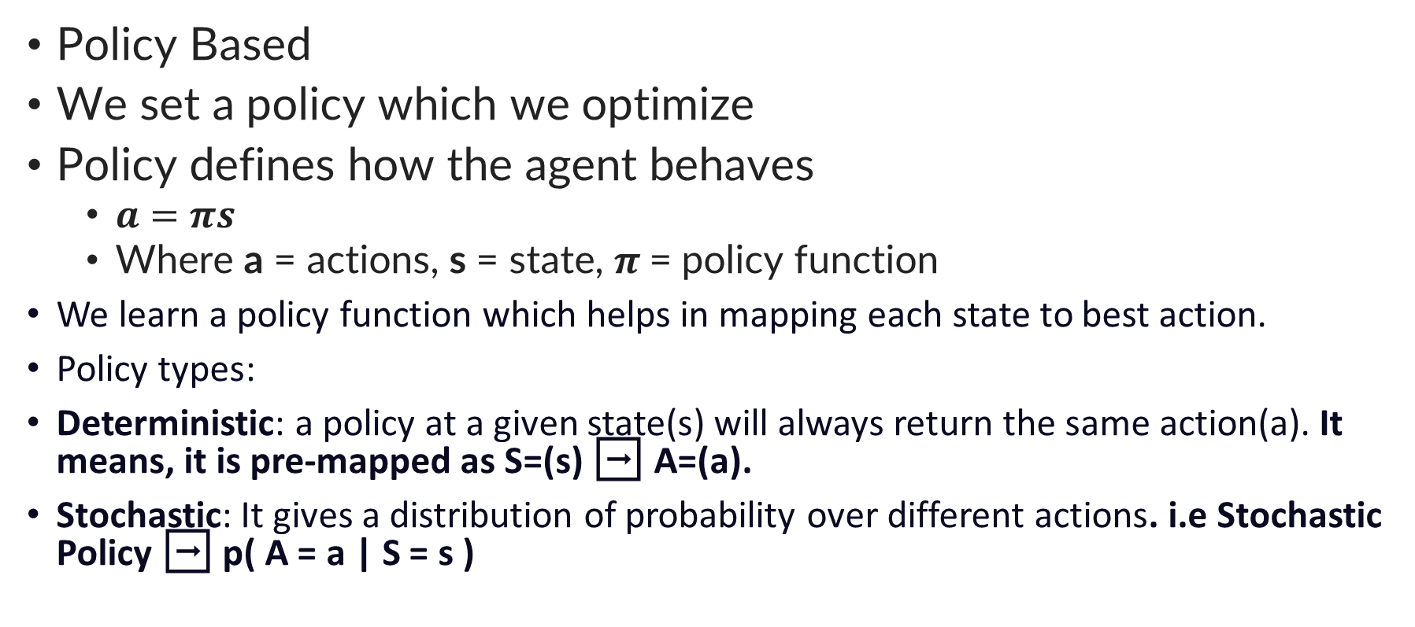
Approaches to Reinforcement Learning
Policy Based
We set a policy which we optimize
Policy defines how the agent behaves
$a=$ $πs$
Where a = actions, s = state, $π$= policy function
We learn a policy function which helps in mapping each state to best action.
Policy types:
Deterministic: a policy at a given state(s) will always return the same action(a). It means, it is pre-mapped as S=(s) ➡ A=(a).
Stochastic: It gives a distribution of probability over different actions. i.e Stochastic Policy ➡ p( A = a | S = s )
8

Slide 9
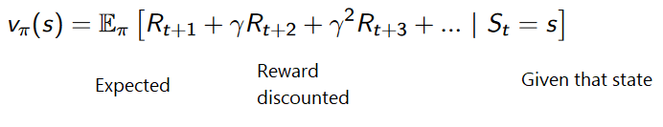
Approaches to Reinforcement Learning
Value Based
Goal of the agent is to optimize the value function V(s)
Value function tells us maximum expected future reward that the agent shall get at each state.
The value of each state is the total amount of the reward an RL agent can expect to collect over the future, from a particular state.
The agent will use the above value function to select which state to choose at each step. The agent will always take the state with the biggest value.
9

Slide 10
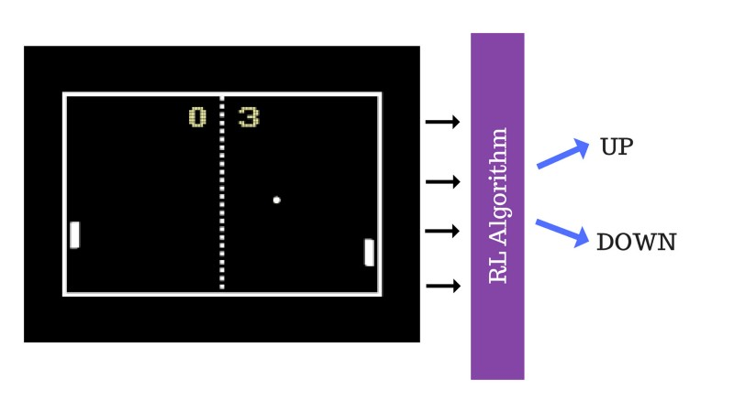
Policy Based Example (Pong)
Feed game frames (new states) to the RL algo
Let algorithm decide where to go up or down.
This network is said to be a policy network.
Method used for training
Policy Gradient
Feed images to algorithm
Algorithm generates random output
Reward assigned to output
Fed back to algorithm
Score board acts as reward
+1 score means action taken was good at that state
10

Slide 11
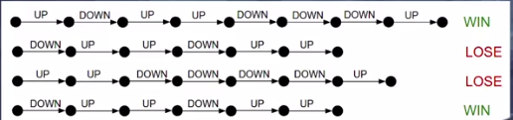
Policy Based Example (Pong)
Let’s train the agent to play the pong game.
At start, feed in a bunch of game frame (states) to algo and let it take random actions.
Initial actions will be bad, but agent might get lucky and win a point.
Due to this lucky random event, it receives a reward
Agent understands that performed series of actions were good enough to fetch a reward.
So, in the future, agent is likely to take the actions which will fetch a reward over an action which will not.
11

Slide 12
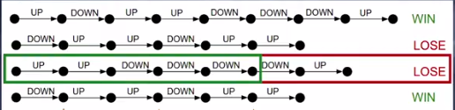
Limitations
During training, when an agent loses an episode
It will discard or lower the likelyhood of taking series of actions in that episode.
What if agent was performing well and made a mistake in last 2 steps?
Should we discard all actions ?
We should remove only last two steps.
This is called credit assignment problem.
Instead of getting reward at each step, agent gets reward at the end
Because of this sparse reward setting algorithm is sample inefficient
Large amount of training data is required
Use reward shaping to solve this problem
12

Slide 13
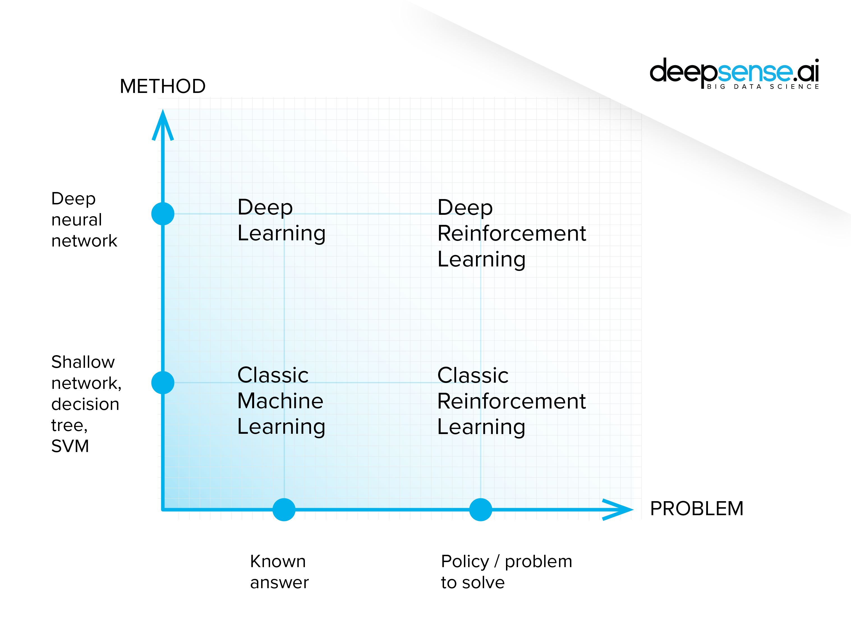
Comparison (ML, DL and RL)
There is no clear divide between machine learning, deep learning and reinforcement learning.
Machine learning is the broadest category and the deep reinforcement learning the most narrow one.
In the same way, RL is a specialized application of ML and DL
13

Slide 14
Applications of RL
Robotics for industrial automation.
Business strategy planning
Machine learning and data processing
Aircraft control and robot motion control
Creating training systems that provide custom instruction and materials according to the requirement of students.
14

Slide 15
Why use RL?
It helps you to find which situation needs an action
Helps you to discover which action yields the highest reward over the longer period.
Reinforcement Learning also provides the learning agent with a reward function.
It also allows it to figure out the best method for obtaining large rewards.
15

Slide 16
Why not use RL?
When you have enough data to solve the problem with a supervised learning method
You need to remember that Reinforcement Learning is computing-heavy and time-consuming, in particular when the action space is large.
16

Slide 17
Challenges related to RL?
Feature/reward design which should be very involved
Parameters may affect the speed of learning.
Realistic environments can have partial observability.
Too much Reinforcement may lead to an overload of states which can diminish the results.
17

Slide 18
Neural Networks and Deep Reinforcement Learning
Remember, Neural networks are function approximators
Therefore, NN are useful in RL when state or action space is too large to be completely known.
NN can approximate a value function, or a policy function.
NN can learn to map states to values, or state-action pairs to values.
Instead of impossible task of building a lookup table to store, index and update all possible states and their values
NN can train on samples from the state or action space to learn to predict how valuable those are relative to our target in reinforcement learning.
NN coefficients approximate the function relating inputs to outputs and reduce error or increase reward
18

Slide 19
Neural Networks and Deep Reinforcement Learning
In RL, CNNs can be used to recognize an agent’s state when the input is visual; e.g. the screen that Mario is on, or the terrain before a drone. That is, they perform their typical task of image recognition.
Generally, CNNs derive different interpretations from images as compared to those in RL.
In supervised CNNs, network applies a label to each image; i.e., it matches names to pixels.
CNNs will provide labels that best fit the image in terms of their probabilities.
Shown an image of a donkey, it might decide the picture is 80% likely to be a donkey, 50% likely to be a horse, and 30% likely to be a dog.
In RL, given an image that represents a state, a CNN ranks actions possible to perform in that state; for example, it might predict that running right will return 5 points, jumping 7, and running left none.
19

Slide 20
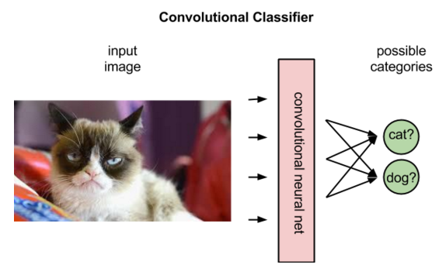
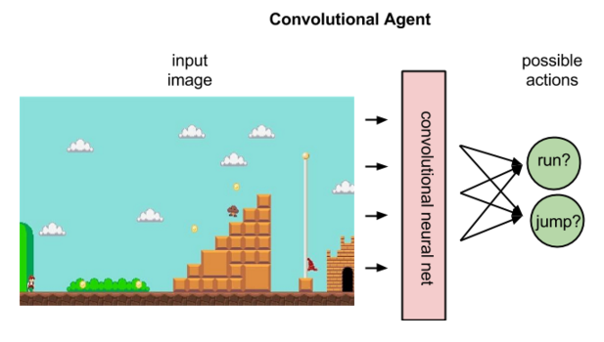
Neural Networks and Deep Reinforcement Learning
Top right image illustrates what a policy agent does, mapping a state to the best action.
A policy maps a state to an action.
Q maps state action pairs to rewards.
Q maps state-action pairs to the highest combination of immediate reward with all future rewards that might be
harvested by later actions in the trajectory.
20

Slide 21
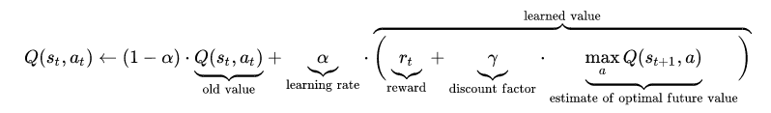
Neural Networks and Deep Reinforcement Learning
Having assigned values to the expected rewards, the Q function simply selects the state-action pair with the highest so-called Q value.
At beginning of RL, the NN coefficients may be initialized stochastically, or randomly.
Next, NN can use difference between its expected reward and the ground-truth reward to adjust its weights and improve its interpretation of state-action pairs.
21

Slide 22
Neural Networks and Deep Reinforcement Learning
In supervised learning, knowledge of the ground-truth and predicted labels push towards the goal of creating a model that maps different images to their respective names.
RL relies on the environment to send it a scalar number in response to each new action.
Rewards returned by the environment can be varied, delayed or affected by unknown variables, introducing noise to the feedback loop.
This leads us to a more complete expression of the Q function, which takes into account not only the immediate rewards produced by an action, but also the delayed rewards that may be returned several time steps deeper in the sequence.
22

Slide 23
Neural Networks and Deep Reinforcement Learning
Like human beings, the Q function is recursive.
Just as calling the method human() contains within it another method human(), of which we are all the fruit, calling the Q function on a given state-action pair requires us to call a nested Q function to predict the value of the next state, which in turn depends on the Q function of the state after that, and so forth.
23

Slide 24
Summary of Terms
Agent(): An entity that can perceive/explore the environment and act upon it.
Environment(): A situation in which an agent is present or surrounded by. In RL, we assume the stochastic environment, which means it is random in nature.
Action(): Actions are the moves taken by an agent within the environment.
State(): State is a situation returned by the environment after each action taken by the agent.
Reward(): A feedback returned to the agent from the environment to evaluate the action of the agent.
Policy(): Policy is a strategy applied by the agent for the next action based on the current state.
Value(): It is expected long-term retuned with the discount factor and opposite to the short-term reward.
Q-value(): It is mostly similar to the value, but it takes one additional parameter as a current action (a).
24

Slide 25
The Bellman Equation
Is associated with dynamic programming
Used to calculate values of a decision problem at a certain point by including values of previous states.
V(s) = max [R(s,a) + γV(s`)]
Where
V(s)= value calculated at a particular point.
R(s,a) = Reward at a particular state s by performing an action.
γ = Discount factor
V(s`) = The value at the previous state.
In the above equation, we are taking the max of the complete values because the agent tries to find the optimal solution always.
25

Slide 26
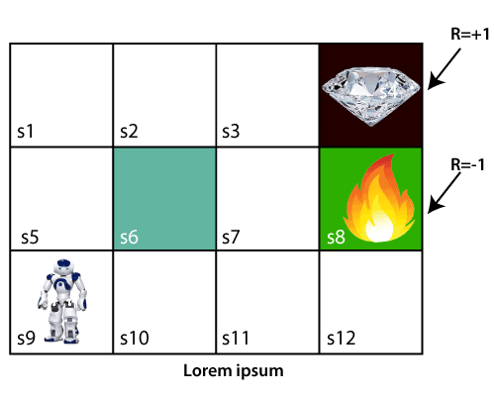
The Bellman Equation
Agent is at very first block of the maze
Maze consisting of a wall at S6 block
Fire pit at S8 a fire pit
Diamond (reward) at S4 block
Agent cannot cross S6 block, as it is solid wall.
If the agent reaches the S4 block, then get the +1 reward
If it reaches the fire pit, then gets -1 reward point.
It can take four actions: move up, move down, move left, and move right.
26

Slide 27
The Bellman Equation
For 1st block:
V(s3) = max [R(s,a) + γV(s`)], here V(s')= 0 because there is no further state to move.
V(s3)= max[R(s,a)]=> V(s3)= max[1]=> V(s3)= 1.
For 2nd block:
V(s2) = max [R(s,a) + γV(s`)], here γ= 0.9(lets), V(s')= 1, and R(s, a)= 0, because there is no reward at this state.
V(s2)= max[0.9(1)]=> V(s)= max[0.9]=> V(s2) =0.9
27

Slide 28
The Bellman Equation
For 3rd block:
V(s1) = max [R(s,a) + γV(s`)], here γ= 0.9(lets), V(s')= 0.9, and R(s, a)= 0, because there is no reward at this state also.
V(s1)= max[0.9(0.9)]=> V(s3)= max[0.81]=> V(s1) =0.81
For 4th block:
V(s5) = max [R(s,a) + γV(s`)], here γ= 0.9(lets), V(s')= 0.81, and R(s, a)= 0, because there is no reward at this state also.
V(s5)= max[0.9(0.81)]=> V(s5)= max[0.81]=> V(s5) =0.73
28

Slide 29
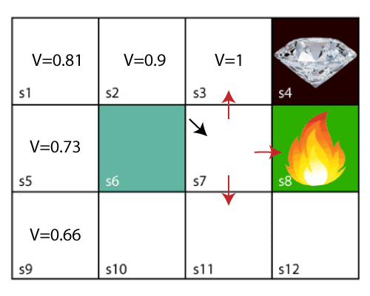
The Bellman Equation
For 5th block:
V(s9) = max [R(s,a) + γV(s`)], here γ= 0.9(lets), V(s')= 0.73, and R(s, a)= 0, because there is no reward at this state also.
V(s9)= max[0.9(0.73)]=> V(s4)= max[0.81]=> V(s4) =0.66
Block next to fire pit:
Agent has three options to move;
Move to S6, hits wall
Moves to the fire pit, reward -1 reward (Negative)
Move upwards
Only option Move upwards
29

Slide 30
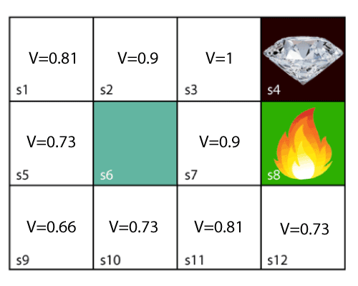
The Bellman Equation
After all calculations
30

